Slide 1

Class9
CSC 495/583 Topics of Software Security Return-oriented programming
(ROP)
Dr. Si Chen (schen@wcupa.edu)

Slide 2
Review

Slide 3
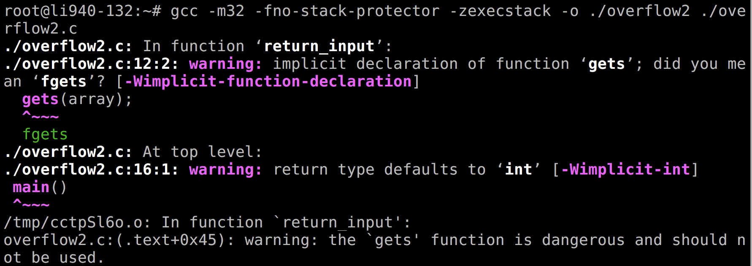
Compile the code
gcc -m32 –fno-stack-protector –zexecstack –o ./overflow2 ./overflow2.c

Slide 4
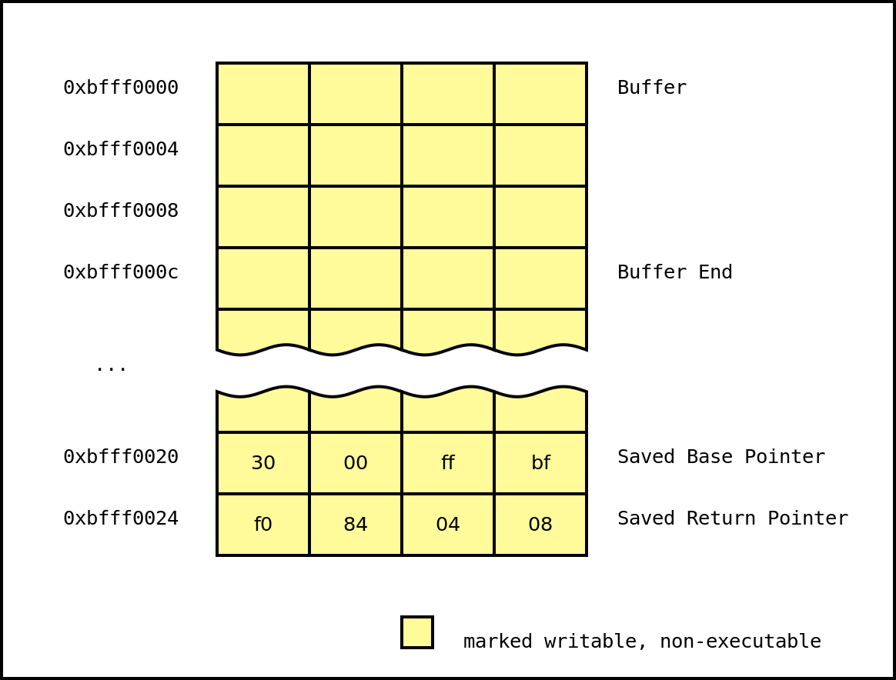
No eXecute (NX)
-zexecstack
Also known as Data Execution Prevention (DEP), this protection marks writable regions of memory as non-executable.
This prevents the processor from executing in these marked regions of memory.

Slide 5
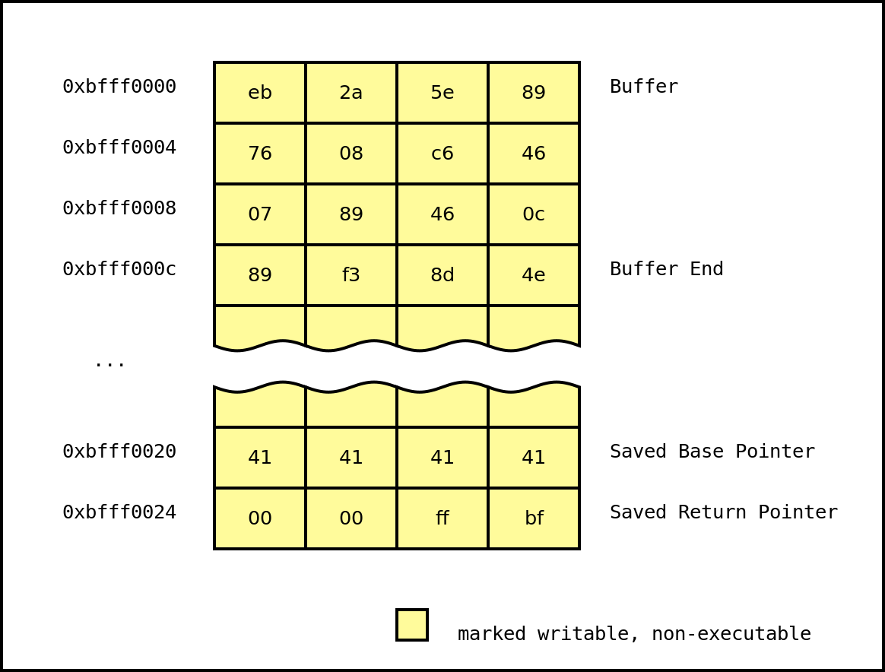
No eXecute (NX)
After the function returns, the program will set the instruction pointer to 0xbfff0000 and attempt to execute the instructions at that address. However, since the region of memory mapped at that address has no execution permissions, the program will crash.

Slide 6
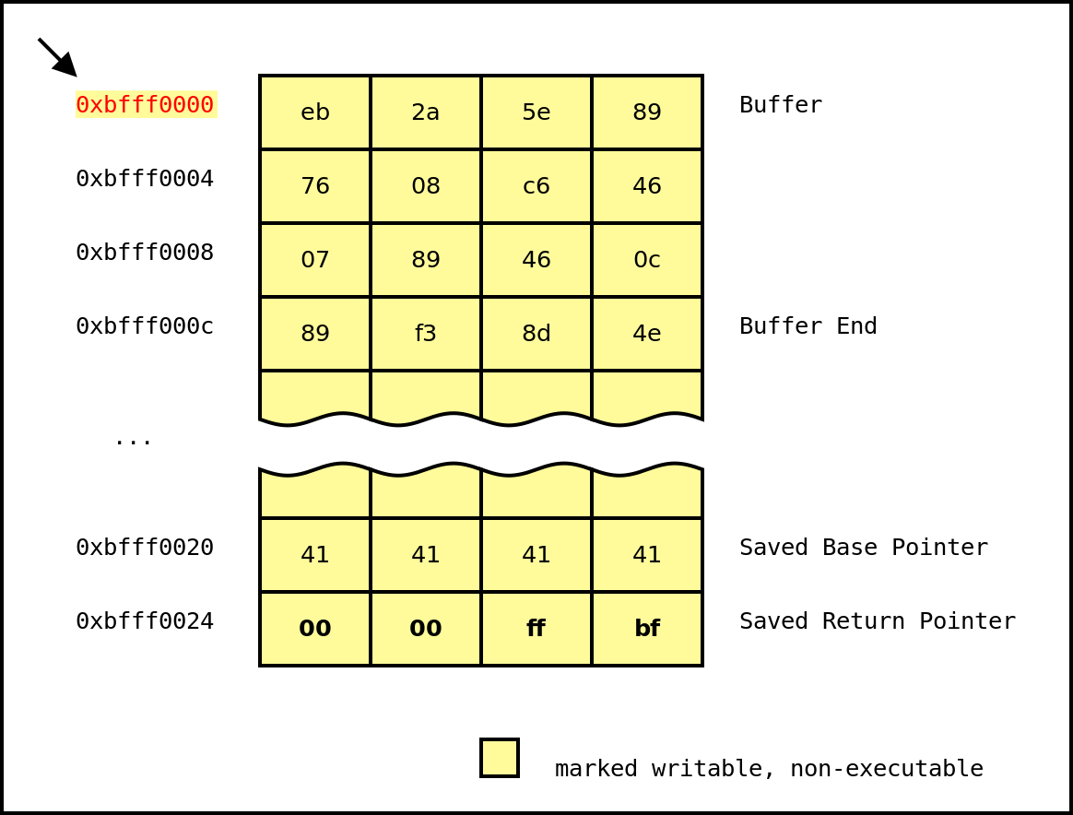
No eXecute (NX)
Thus, the attacker's exploit is thwarted.

Slide 7
Data Execution Prevention (DEP): No eXecute bit (NX)
NX bit is a CPU feature
–
On Intel CPU, it works only on x86_64 or with Physical Address Extension (PAE) enable
Enabled, it raises an exception if the CPU tries to
execute something that doesn't have the NX bit set
The NX bit is located and setup in the Page Table Entry

Slide 8
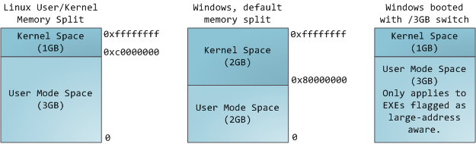
Page Table
Each process in a multi-tasking OS runs in its own memory sandbox.
This sandbox is the virtual address space, which in 32-bit mode is always a 4GB block of memory addresses.
These virtual addresses are mapped to physical memory by page tables, which are maintained by the operating system kernel and consulted by the processor.
Each process has its own set of page tables.

Slide 9
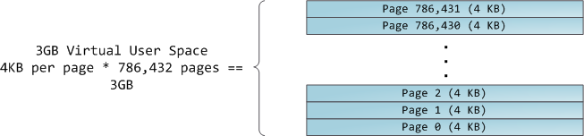
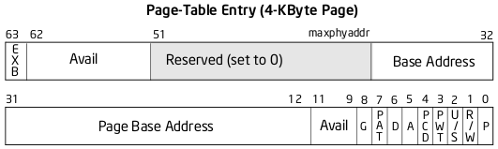
Page Table
To each virtual page there corresponds one page table entry (PTE) in the page tables, which in regular x86 paging is a simple 4-byte record shown below:

Slide 10
Data Execution Prevention (DEP): No eXecute bit (NX)
●
The last bit is the NX bit (exb)
–
0 = disabled
1 = enabled
–

Slide 11
Return-oriented programming
(ROP)

Slide 12
ROP Introduction
●
When Good Instructions Go Bad: Generalizing Return-Oriented Programming to RISC
[1] -Buchanan, E.; Roemer, R.; Shacham, H.; Savage, S. (October 2008)
●
Return-Oriented Programming: Exploits Without Code Injection
[2] - Shacham, Hovav; Buchanan, Erik; Roemer, Ryan; Savage, Stefan. Retrieved 2009-08-12.

Slide 13



Ordinary programming: the machine level
insn | insn | insn | insn
instruction pointer
Instruction pointer (EIP) determines which instruction to fetch & execute
Once processor has executed the instruction, it automatically increments EIP to next instruction
Control flow by changing value of EIP

Slide 14
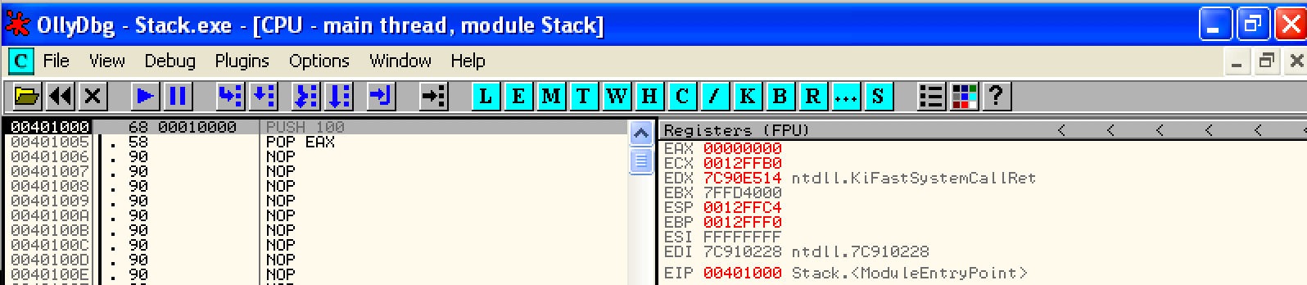
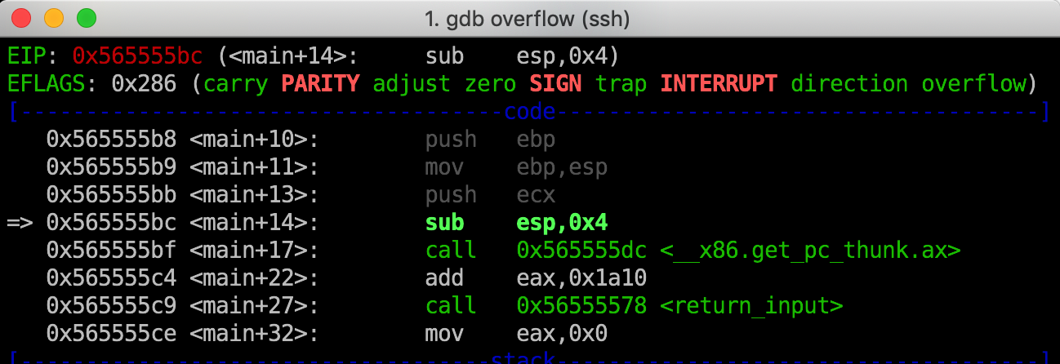
EIP
Instruction pointer (EIP) determines which instruction to fetch & execute
Once processor has executed the instruction, it automatically increments EIP to next instruction
Control flow by changing value of EIP

Slide 15


Return-oriented programming: the machine level
insns … ret
insns … ret
C library
insns … ret
insns … ret
insns … ret
stack pointer
Stack pointer (ESP) determines which instruction sequence to fetch & execute
Processor doesn’t automatically increment ESP; — but the “ret” at end of each instruction sequence does

Slide 16
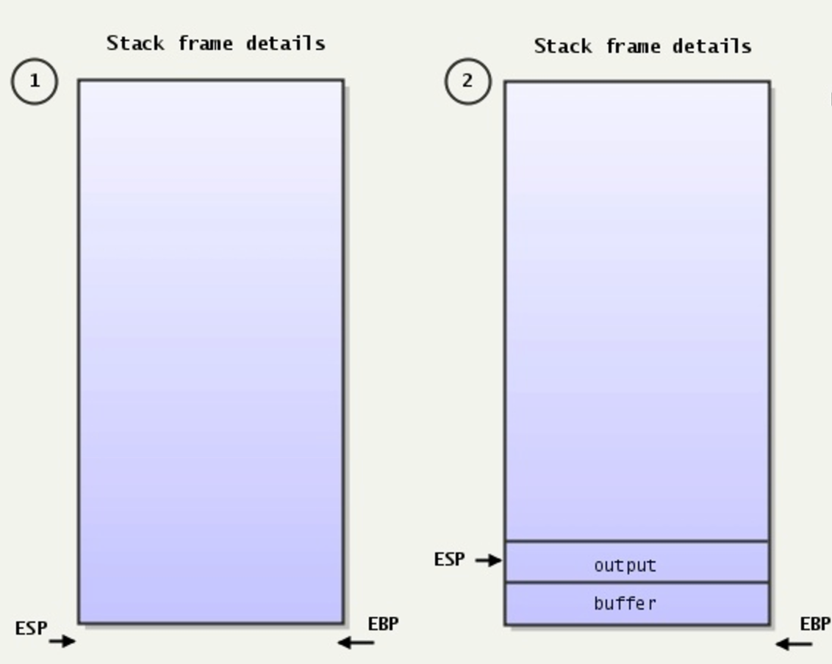
ESP – Always pointing to the top of the stack
Stack pointer (ESP) determines which instruction sequence to fetch & execute
Processor doesn’t automatically increment ESP; — but the “ret” at end of each instruction sequence does

Slide 17
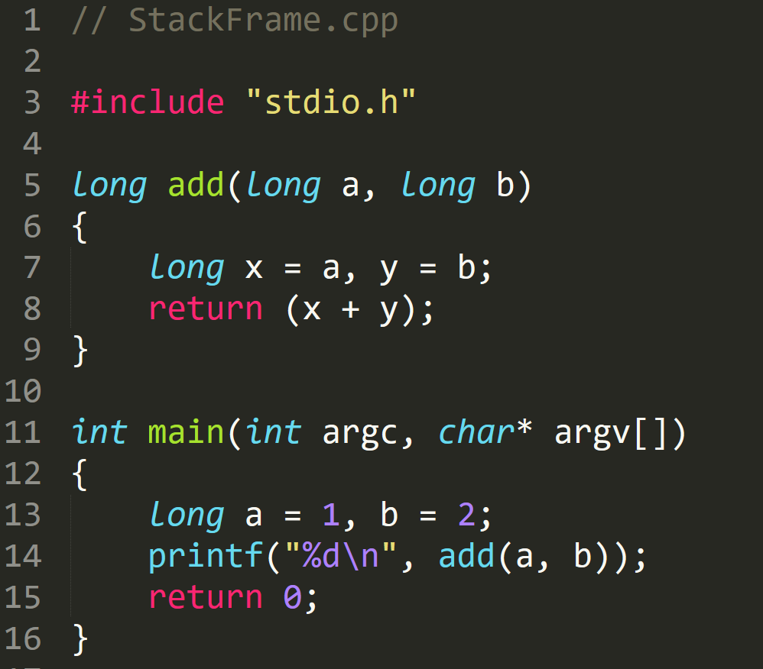
StackFrame.exe
ESP:
EBP:
0xdeadbeef
EIP:
0xcafebabe
0xdeadbeef
Old EBP
Return Address
(Back to Main function)
0xcafebabe
0xcafebabe

Slide 18
ROP: The Main Idea

Slide 19

ROP Gadget
“The Gadget”: July 1945

Slide 20
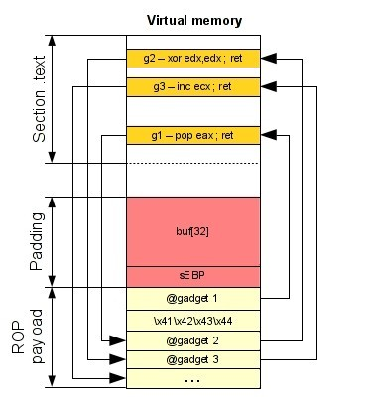
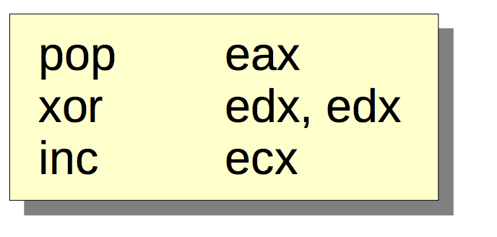
Attack Process on x86
Gadget1 is executed and returns
Gadget2 is executed and returns
Gadget3 is executed and returns
●
So, the real execution is:

Slide 21
How can we ﬁnd gadgets?
Several ways to find gadgets
Old school method : objdump and grep
Some gadgets will be not found: objdump aligns instructions
Make your own tool which scans an executable segment
Use an existing tool

Slide 22
Finding instruction sequences
Any instruction sequence ending in “ret” is useful — could be part of a gadget
Algorithmic problem: recover all sequences of valid instructions from libc that end in a “ret” insn
Idea: at each ret (c3 byte) look back:
are preceding i bytes a valid length-i insn?
recurse from found instructions
Collect instruction sequences in a trie

Slide 23
ROPgadget

Slide 24
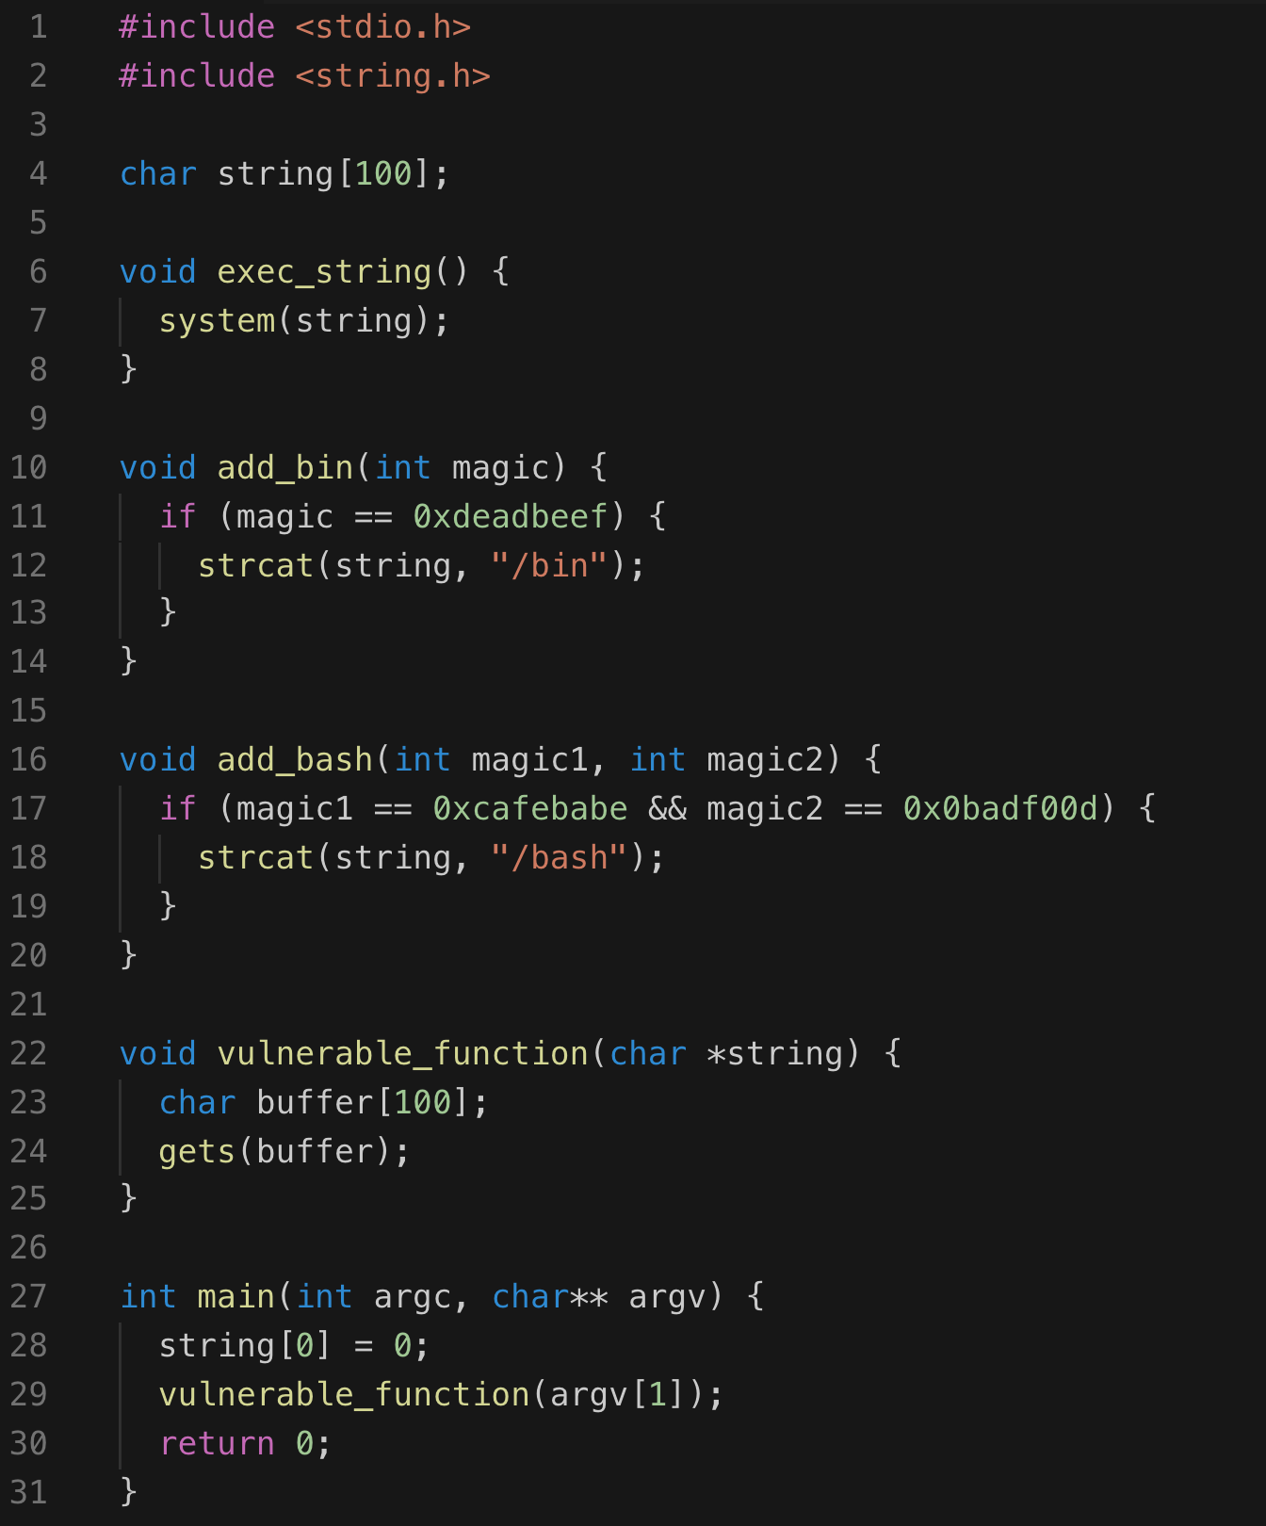
Execution Path
main()
→ vulnerable_function (hacked)
→ add_bash()
add_bin()
exec_string()
Spawn shell

Slide 25
x
Execution Path
add_bash()
magic1 == 0xcafebabe
magic2 == 0x0badf00d
add_bin()
magic == 0xdeadbeef
exec_string()
Spawn shell

Slide 26
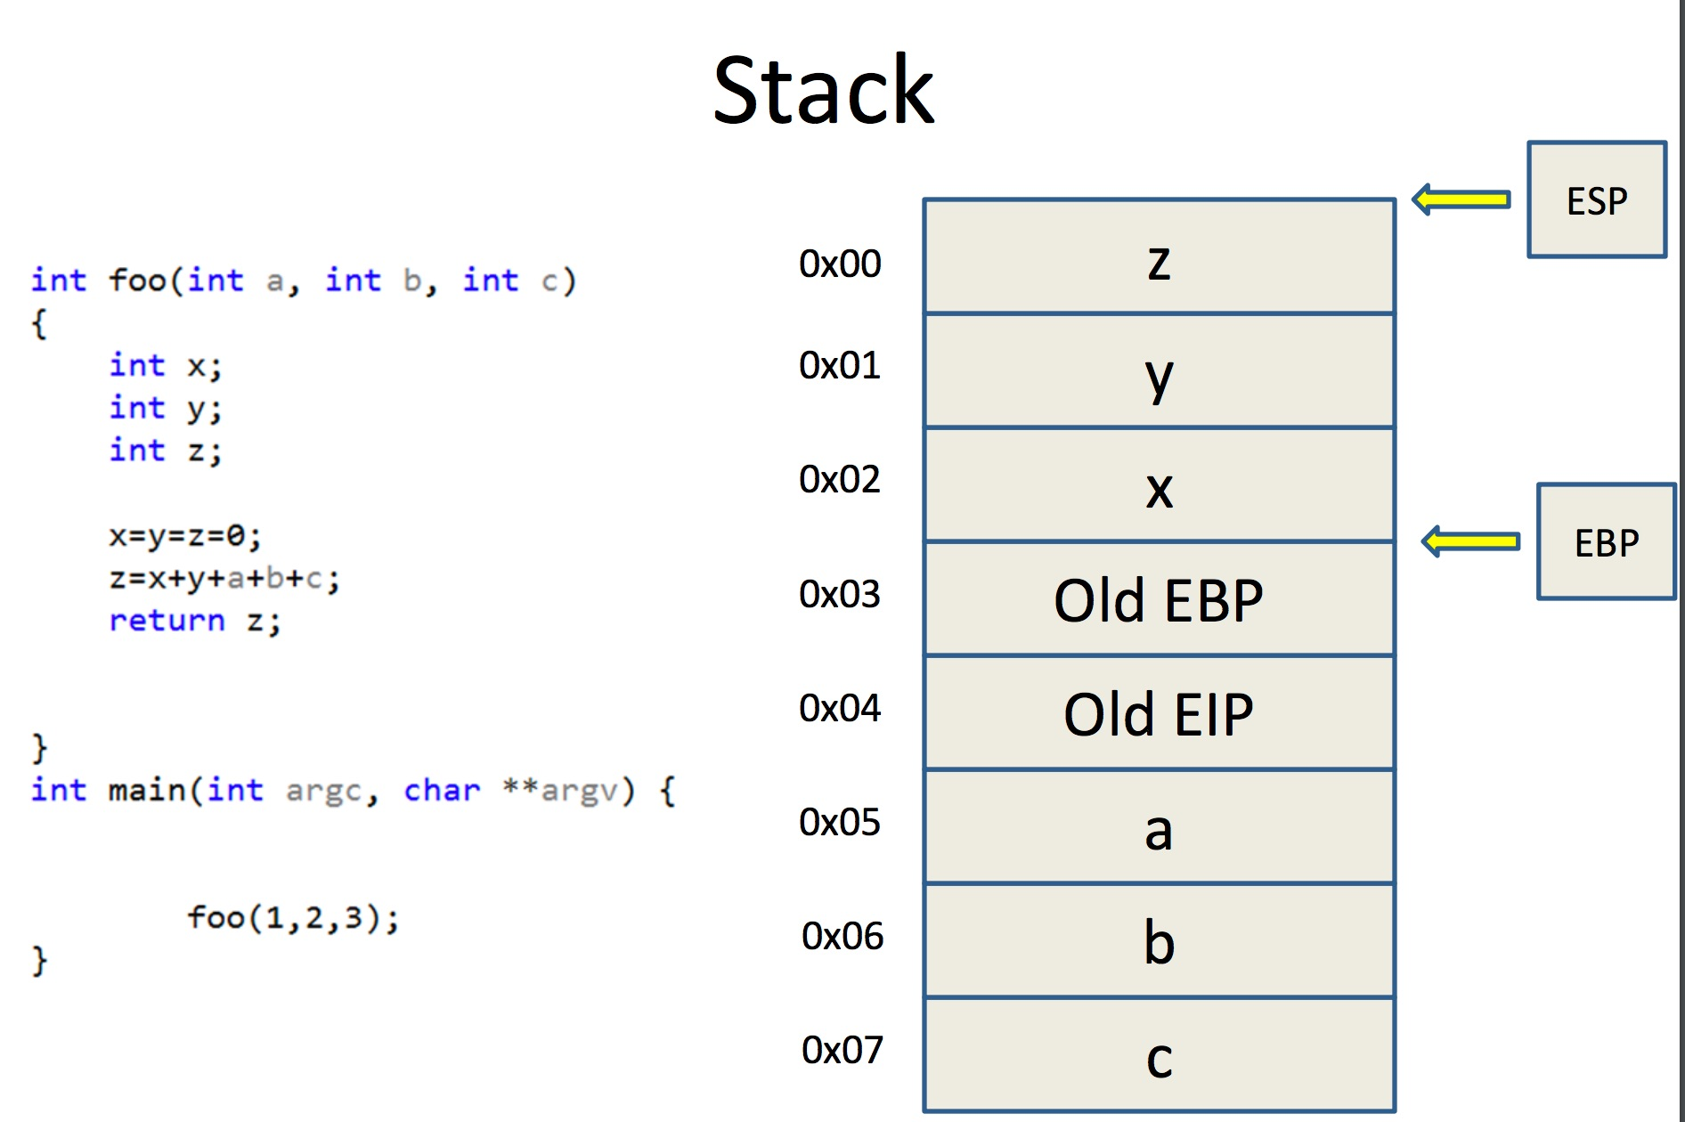

Slide 27
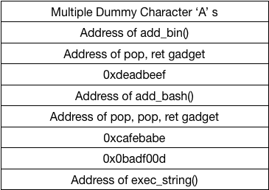

Slide 28
Similarly to lab1, we use gdb to adjust the length of the dummy characters to trigger buffer overflow

Slide 29
The ROP chain should call add_bin() function first, then use a
pop, ret
gadget to push the argument 0xdeadbeef into ebp to make sure magic == 0xdeadbeef

Slide 30
Q & A

